Slide 1
Taking Flight
JZ Flight School Analysis

Slide 2
Summary
Key findings:
Cessna, Bell, and Piper aircrafts are the safest airplanes.
Cessna 172, Cessna 158, or Piper PA-28
Most dangerous flight phases: initial climb, cruise, and maneuvering
Most dangerous time of year to fly: winter

Slide 3
Outline
Business Problem
Data & Methods
Results
Conclusions

Slide 4
Business Problem
Determine the safest plane models to purchase for instruction.
Determine the most dangerous flight phases.
Determine the most dangerous seasons for flying.

Slide 5
Data & Methods
Safety Metric: Protecting passengers during an accident
Fraction of passengers killed during an accident.
Fraction of passengers injured during an accident.
Focused on smaller aircraft

Slide 6
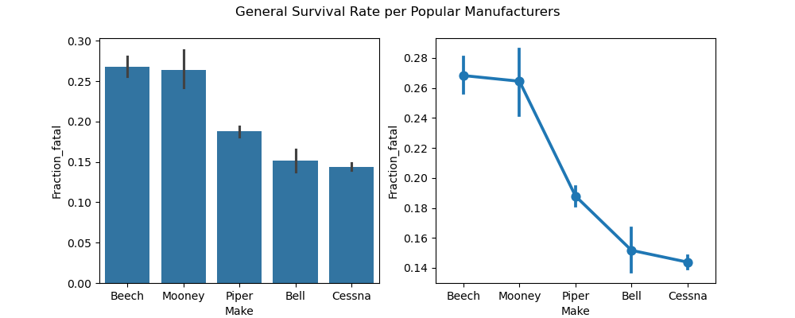
Results
Cessna and Piper have the best safety metrics.

Slide 7
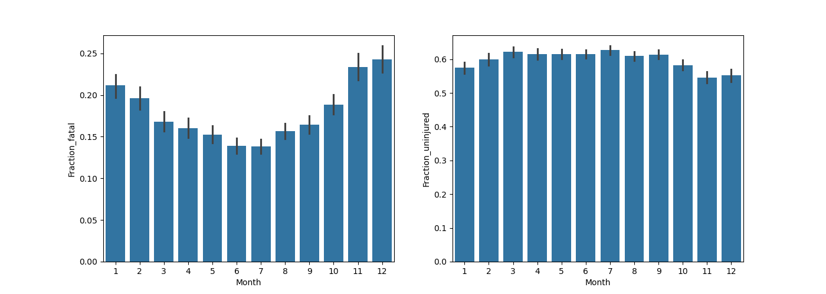
Results
The winter months are the most dangerous for flying.

Slide 8
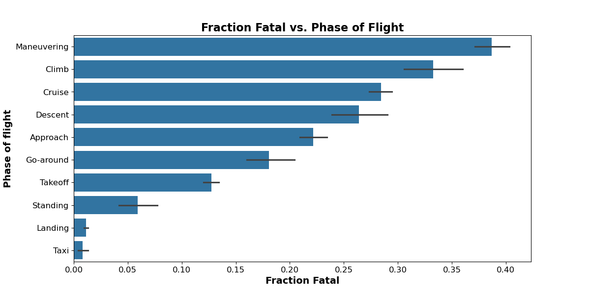
Results
The initial climb, maneuvering, and cruise phases are the most dangerous.

Slide 9
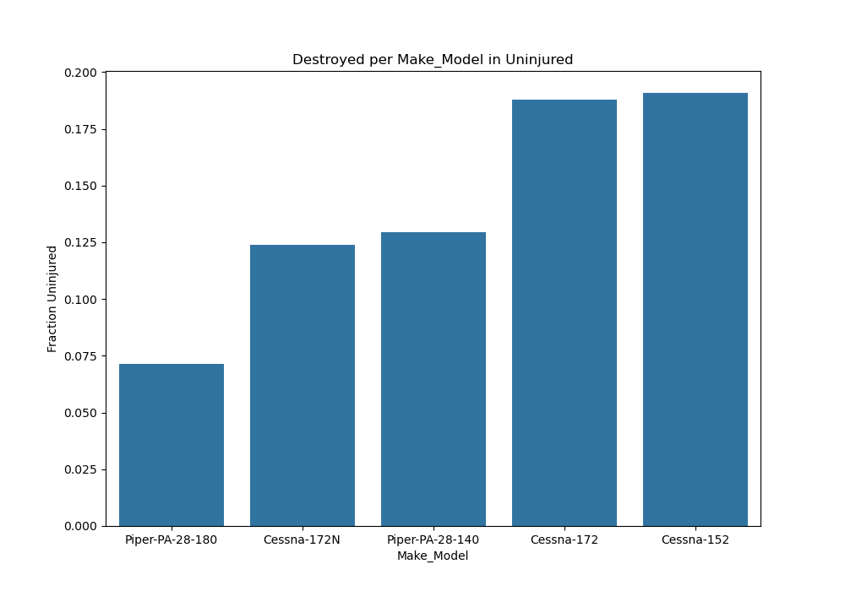
Results
The Cessna 152, 172 and the Piper PA-28 are the safest models.

Slide 10
Conclusion
Consider Cessna or Piper makes (Cessna 172, 158, or Piper PA-28).
Focus on safety during climb, cruise, and maneuvering phases of flight.
Focus on safety during winter flying.
Next Steps:
Investigate the geographical locations of accidents to gain insight.
Investigate weather conditions.

Slide 11
Thank You!
Email: kagaizacharia@gmail.com
Github: ZachariaMwaura
LinkedIn:
Email: jeffreygoett9@gmail.com
Github: @jgoett2
LinkedIn: https://www.linkedin.com/in/jeffrey-g-3b3a83a

